Slide 1
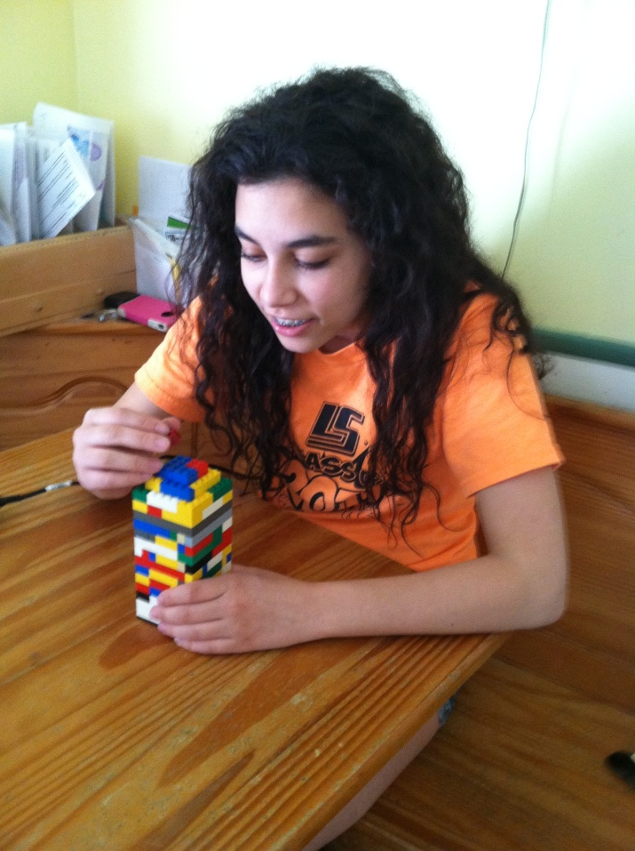
Biomedical Engineers Architecture and Engineering
Sara Nevedal
Lake Shore 5/7/14 4th hour
Career/Technology Foundations

Slide 2
Introduction
“The price of success is hard work, dedication to the job at hand, and the determination that whether we win or lose, we have applied the best of ourselves to the task at hand.”-Vince Lombardi. Being a biomedical engineer takes a lot of work, but I know it pay of when I make something awesome and useful. I’m interested in having something new and challenging everyday. I have always loved math and science so this career fits. In order to get a better understanding of my career as a biomedical engineer, I will be researching the nature of the work; working conditions; training, qualifications, advancement; job outlook/employments; earnings; and a related occupation.

Slide 3
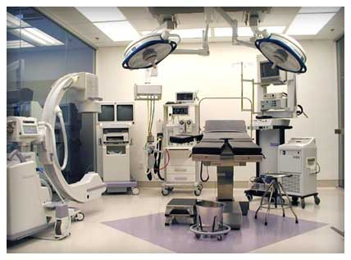
Nature of Work
Design systems and products, such as artificial internal organs, artificial devices that replace body parts, and machines for diagnosing medical problems
Install, adjust, maintain, repair, or provide technical support for biomedical equipment
Evaluate the safety, efficiency, and effectiveness of biomedical equipment
Train clinicians and other personnel on the proper use of equipment
Work with life scientists, chemists, and medical scientists to research the engineering aspects of biological systems of humans and animals

Slide 4
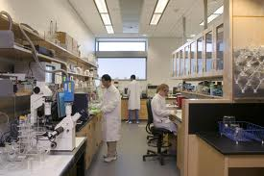
Working Conditions
Mental: Must design and create things
Indoors: Mostly working in laboratories or hospitals
Most engineers work full time
Flexible hours, most of the time working until the project is done

Slide 5
Training, Qualification, Advancement
Bachelor’s degree in biomedical engineering
Graduate’s degree in either biomedical or different engineering field, or on the job training
Where: University of Michigan
In high school: Lots of science classes including:
784A/B/C Mech Engineer/Design Studio I
786 A/B/C Mech Engineer/Design Studio II

Slide 6
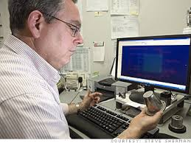
Job Outlook/Employment
Employment rate: 27% increase
Where I want to live: St. Clair Shores, Michigan
Where I want to work: Any where I can get a job
Small career, not a lot of jobs

Slide 7
Earnings
Median Salary: $86,960
Goals:
Own a Siberian husky, $800 +
Swim with dolphins, $525 +
Watch the ball drop on New Years Eve in Times Square, $293 +

Slide 8
High School Teacher
Teach students as an entire class or in small groups
Bachelor’s degree
Job outlook: 6% rise
Salary: $55,050 per year

Slide 9
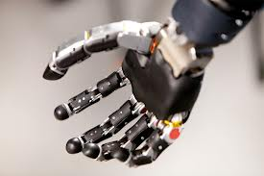
Conclusion
After researching this career I’m still interested in biomedical engineering. My favorite part of this job is that I get to design artificial parts and machines. I like that I get to help people. I do not look forward to fixing machines. I learned that this is a small field so I’m going to have to work really hard to get a job. I also learned that some biomedical engineers work in hospitals, which seems really cool to me.

Slide 10
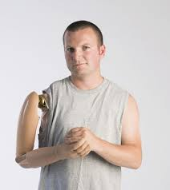
Citations
http://www.bls.gov/ooh/architecture-and- engineering/biomedical-engineers.htm
http://www.quotegarden.com/

